Slide 1
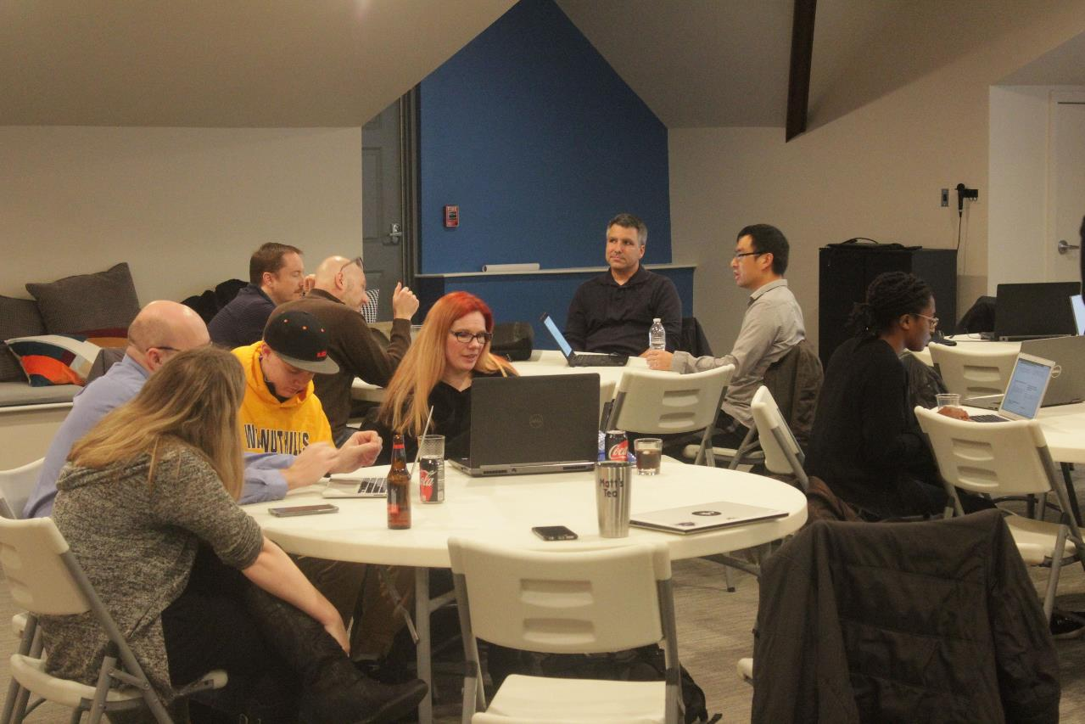
Code, Craft, Community
3/20/2024

Slide 2
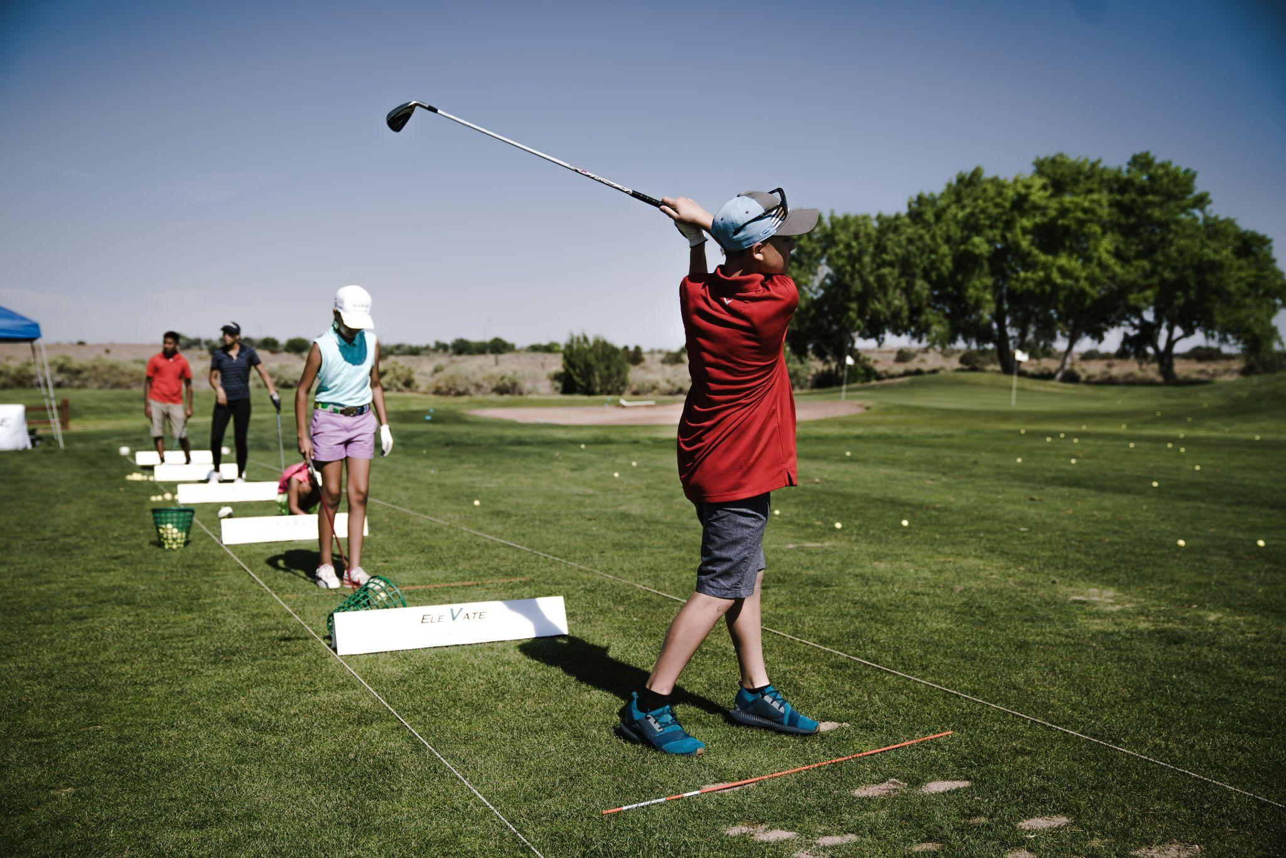
Notes:
Practice

Slide 3
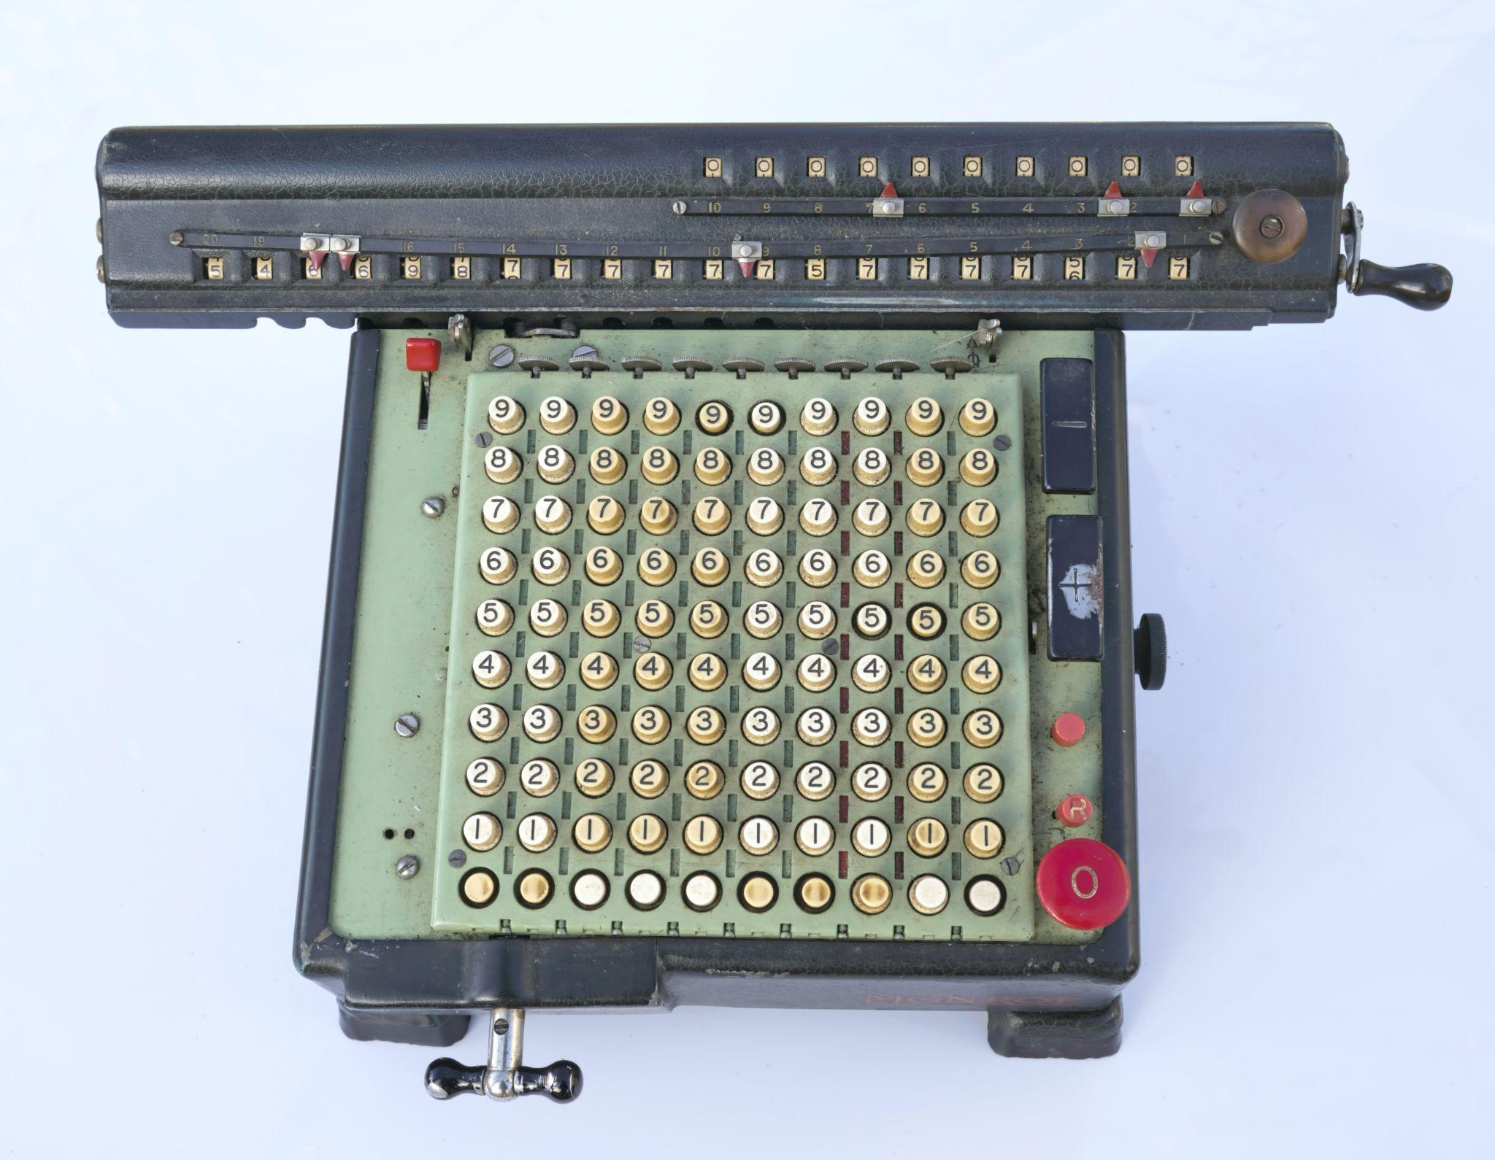
Photo by Loren Biser on Unsplash
Notes:
Technology Agnostic

Slide 4
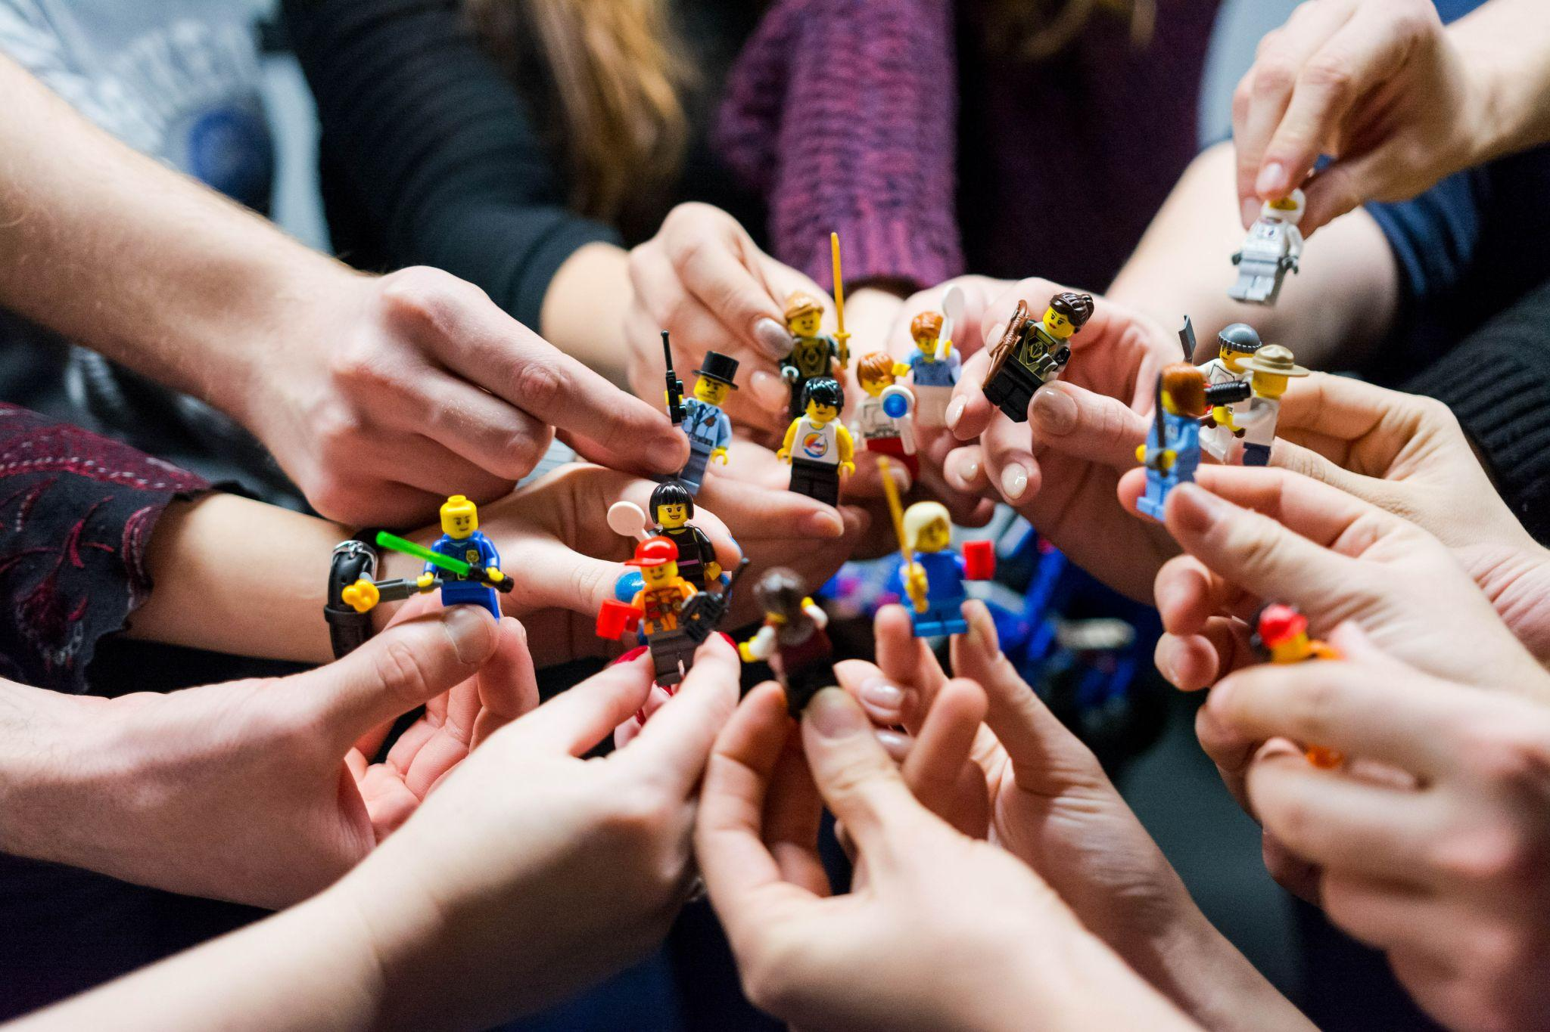
Photo by Vlad Hilitanu on Unsplash
Notes:
Better together

Slide 5

Notes:
Point at code

Slide 6


Photo by Mimi Thian on Unsplash
Notes:
More pointing

Slide 7

Photo by Walkator on Unsplash
Notes:
write code

Slide 8
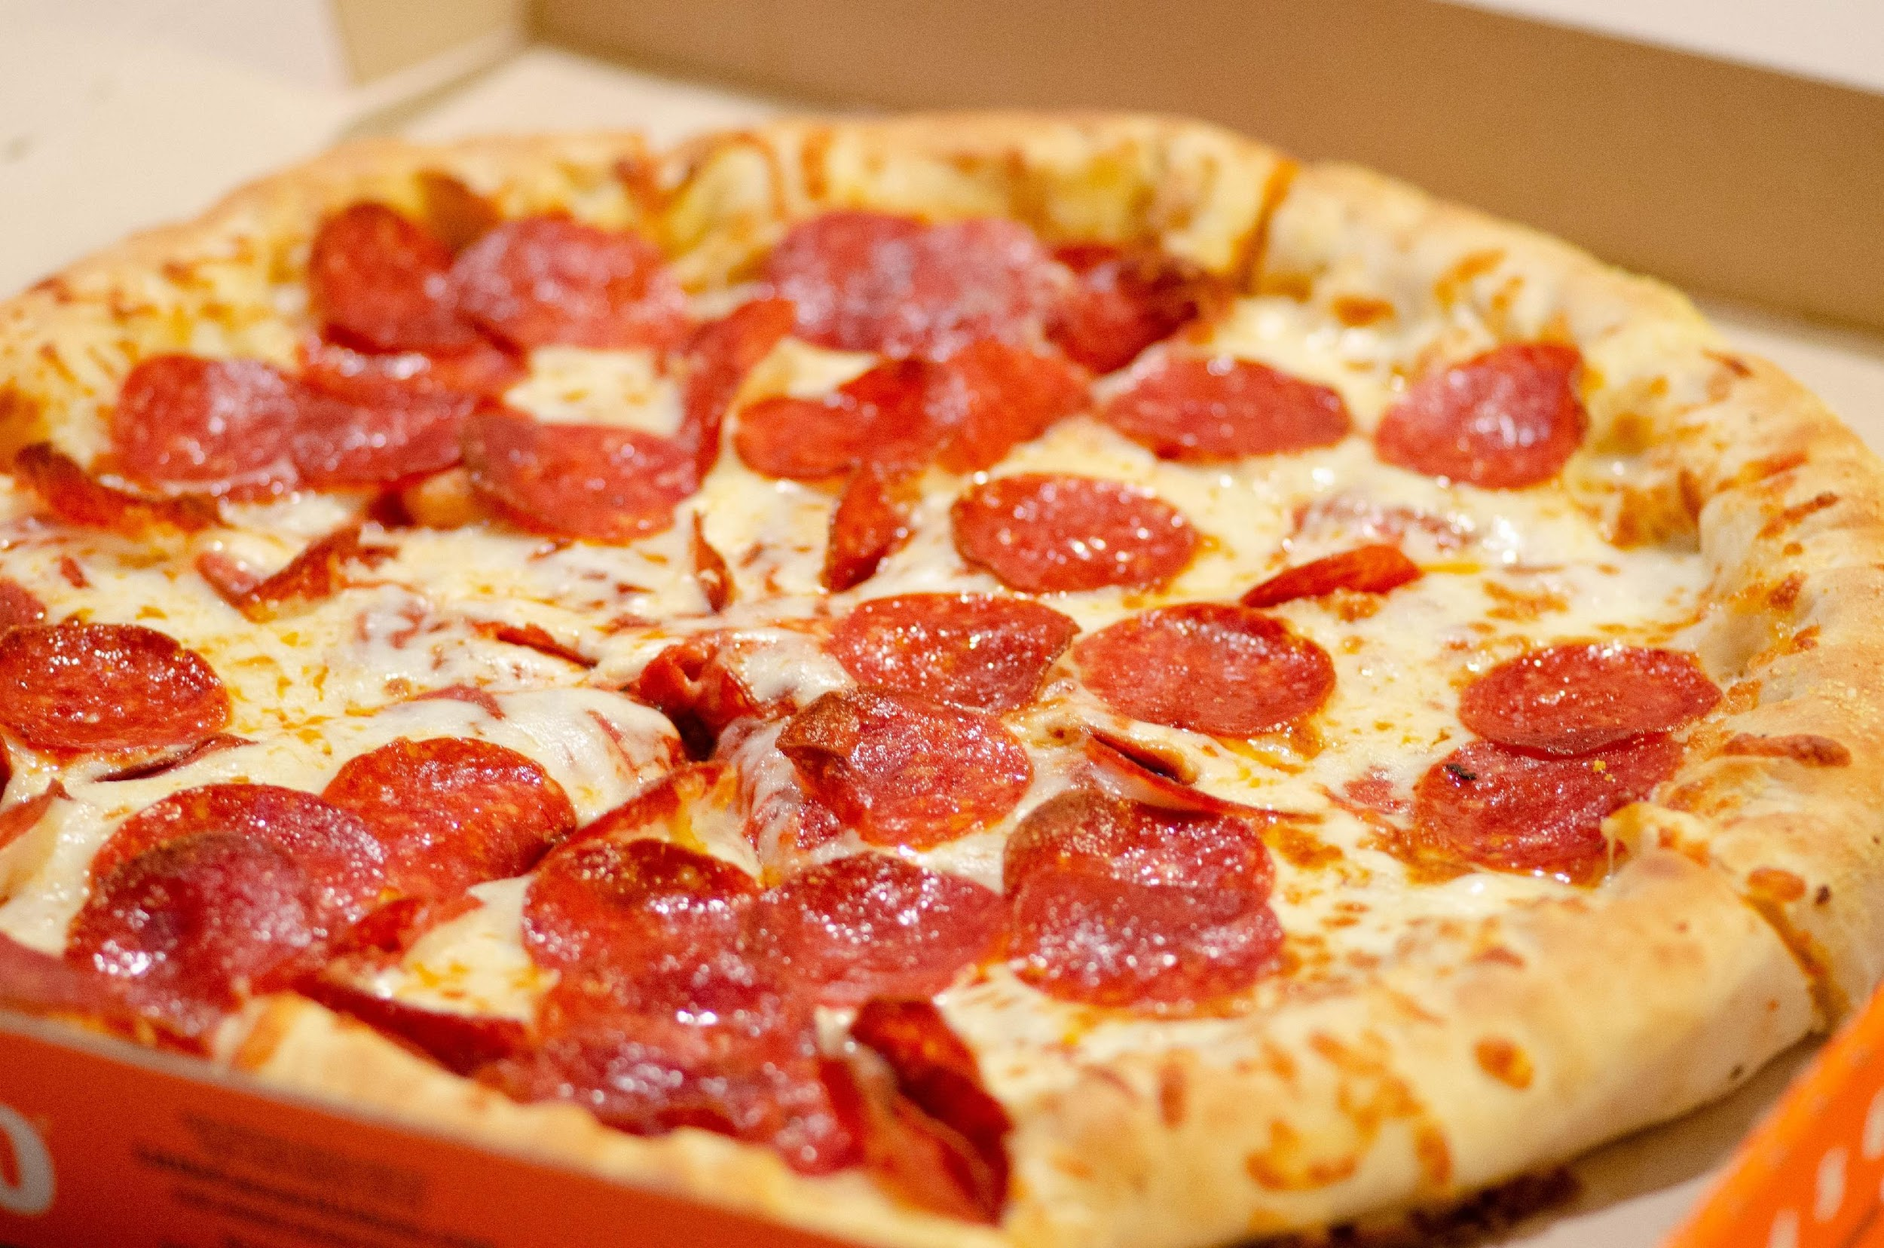
Photo by Alan Hardman on Unsplash
Notes:
pizza

Slide 9
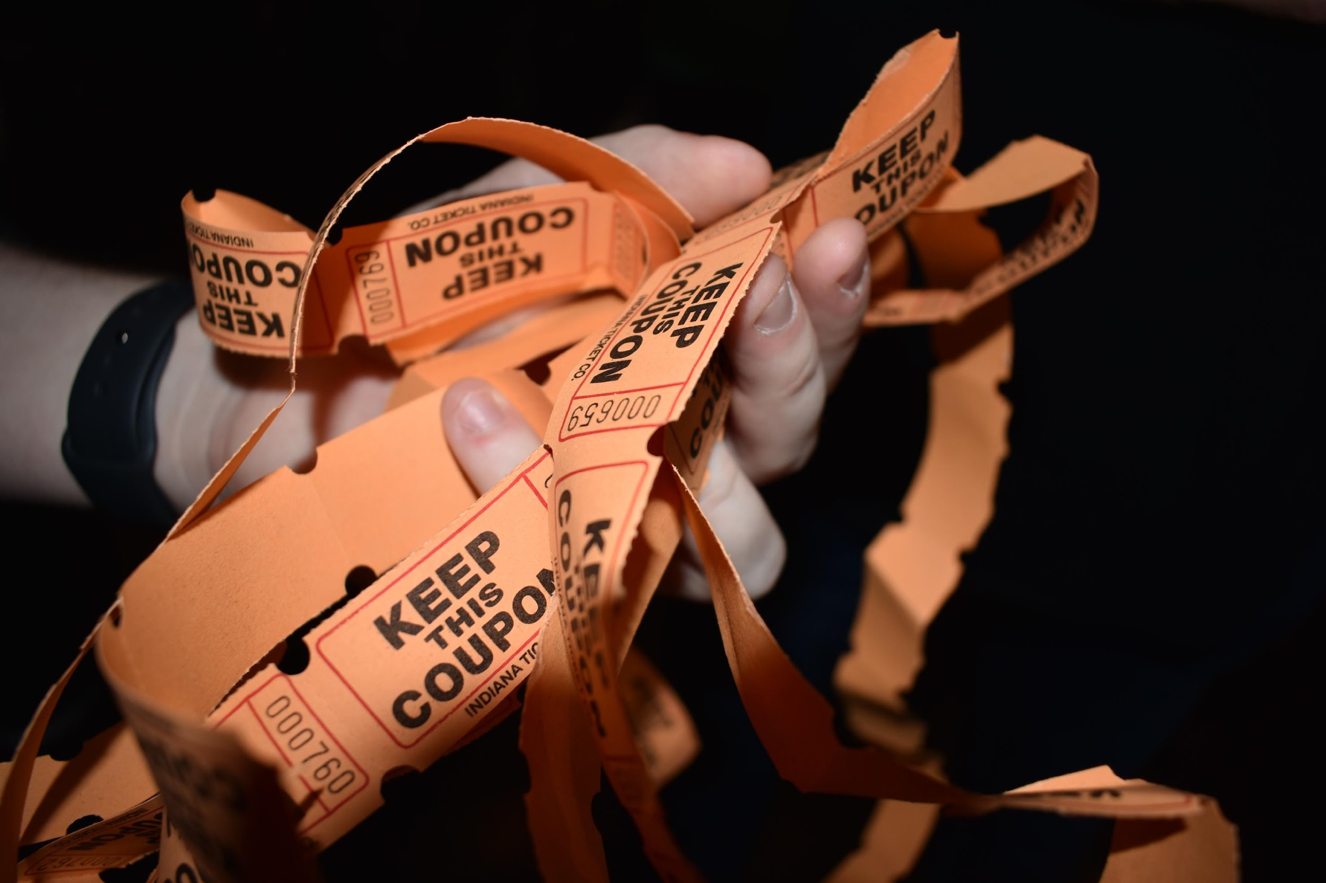
Photo by Julia Morales on Unsplash
Notes:
raffle

Slide 10
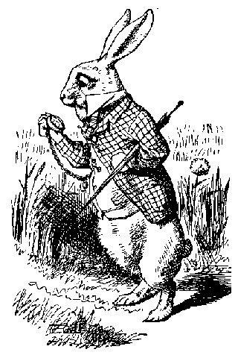
Wonderland Number
Wonderland is a strange place.
There is a wonderland number that is also
quite strange.
It has six digits
If you multiply it by 2, 3, 4, 5 or 6, the resulting number has all the same digits in at as the original number. The only difference is the position that they are in.
Credit: https://github.com/gigasquid/wonderland-clojure-katas/tree/master/wonderland-number
Notes:
Give overview of the challenge
Point out that it is easy
Explain how I looked for smaller number that fits the rule
Then looked for larger numbers
Advent of Code

Slide 11
Next, remove the six digit rule, but still apply the multiplication
rules. See how many you can find in under a second. I found a
solution that can find 1000 numbers in under 20ms.
Hints
function should accept number to find and return an array of numbers
start with 1 and slowly increment that number and observe how long it takes on each increment
Focus optimizations on one area at a time
Use critical thinking, mathematical reasoning, and algorithmic skills
Notes:
How we will enhance it

Slide 12
Wifi Password: ComeJoinUs2!
https://github.com/Ingage-Meetup/20240417-wonderland-number

Slide 13
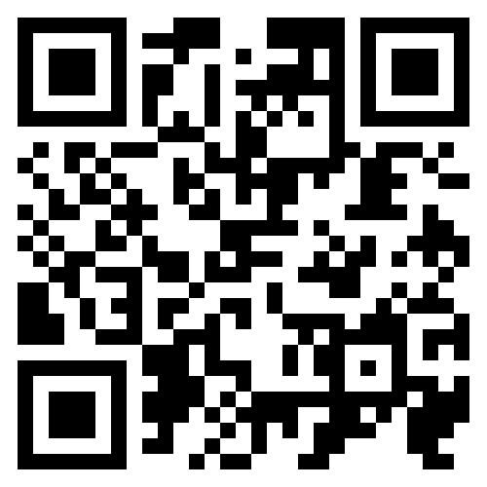
Discord Server
https://discord.gg/bqPVXD4d

Slide 14

Handy QR Codes

Slide 15
Raffle
A Jetbrains license, good for any of their IDEs (IntelliJ, WebStorm, etc.) for one year. It is a “perpetual fallback license”, meaning you can continue to use the version of the IDE that was activated, even after the year has passed and the license is expired.
Winners, talk to Jim Kriz, who will send you a PDF with details to redeem your license.
Notes:
Suppose you're on a game show, and you're given the choice of three doors: Behind one door is a car; behind the others, goats. You pick a door, say No. 1, and the host, who knows what's behind the doors, opens another door, say No. 3, which has a goat. He then says to you, "Do you want to pick door No. 2?" Is it to your advantage to switch your choice?

Slide 16
As developers we are:
…deliberately trying to get better
…not focused on any particular stack, vendor, or language
…better as a group
…here to write code, think about code, discuss the craft
…dreaming of eating pizza together

